Slide 1
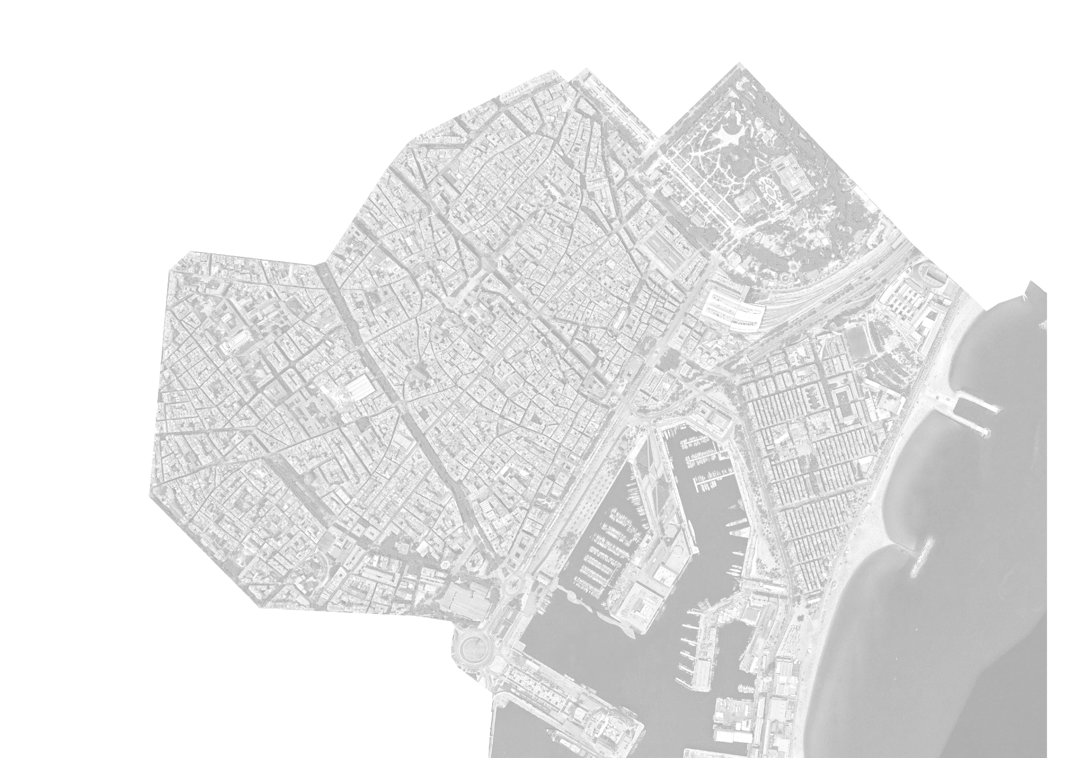
CIUTAT (B)ELLA
GENTRIFICATION HUNTERS

Slide 2
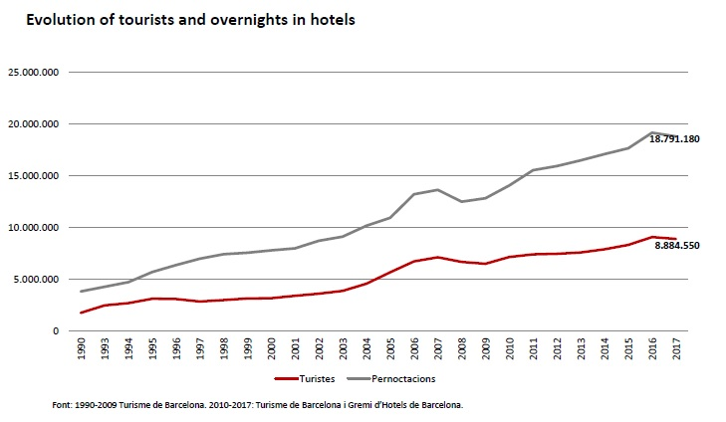
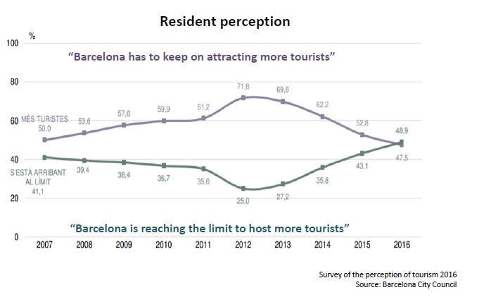
GENTRIFICATION
Rent prices
Tourism

Slide 3
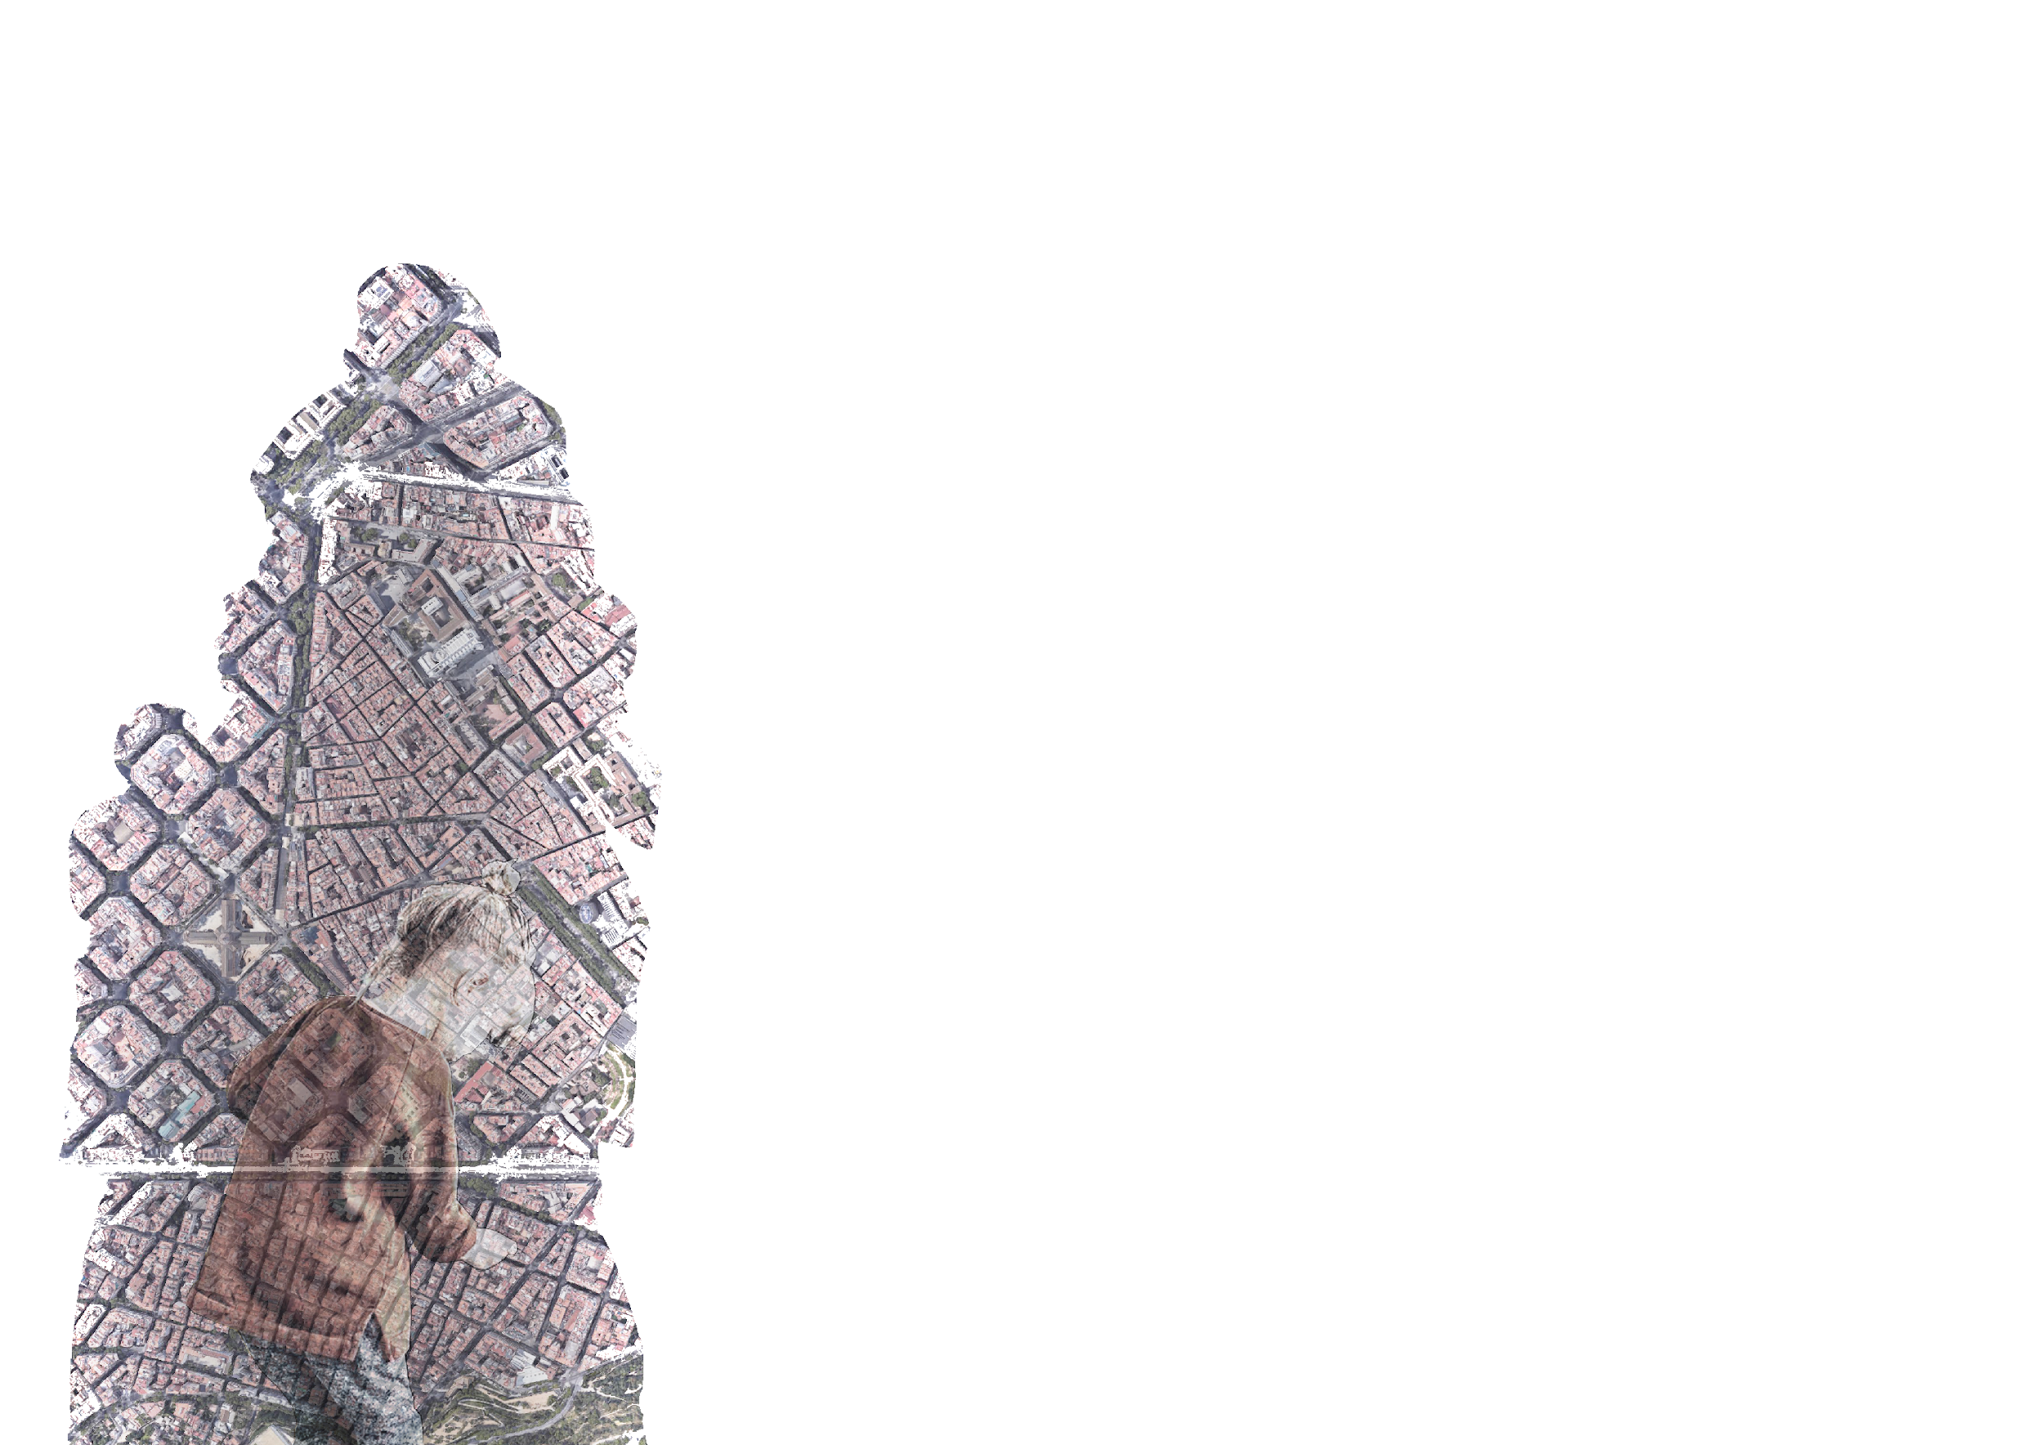
SOME EXAMPLES
Gentrification can generate routine changes
Increasing rent prices vs low increasing of income
Displacements of neighbours
Alienation of locals

Slide 4
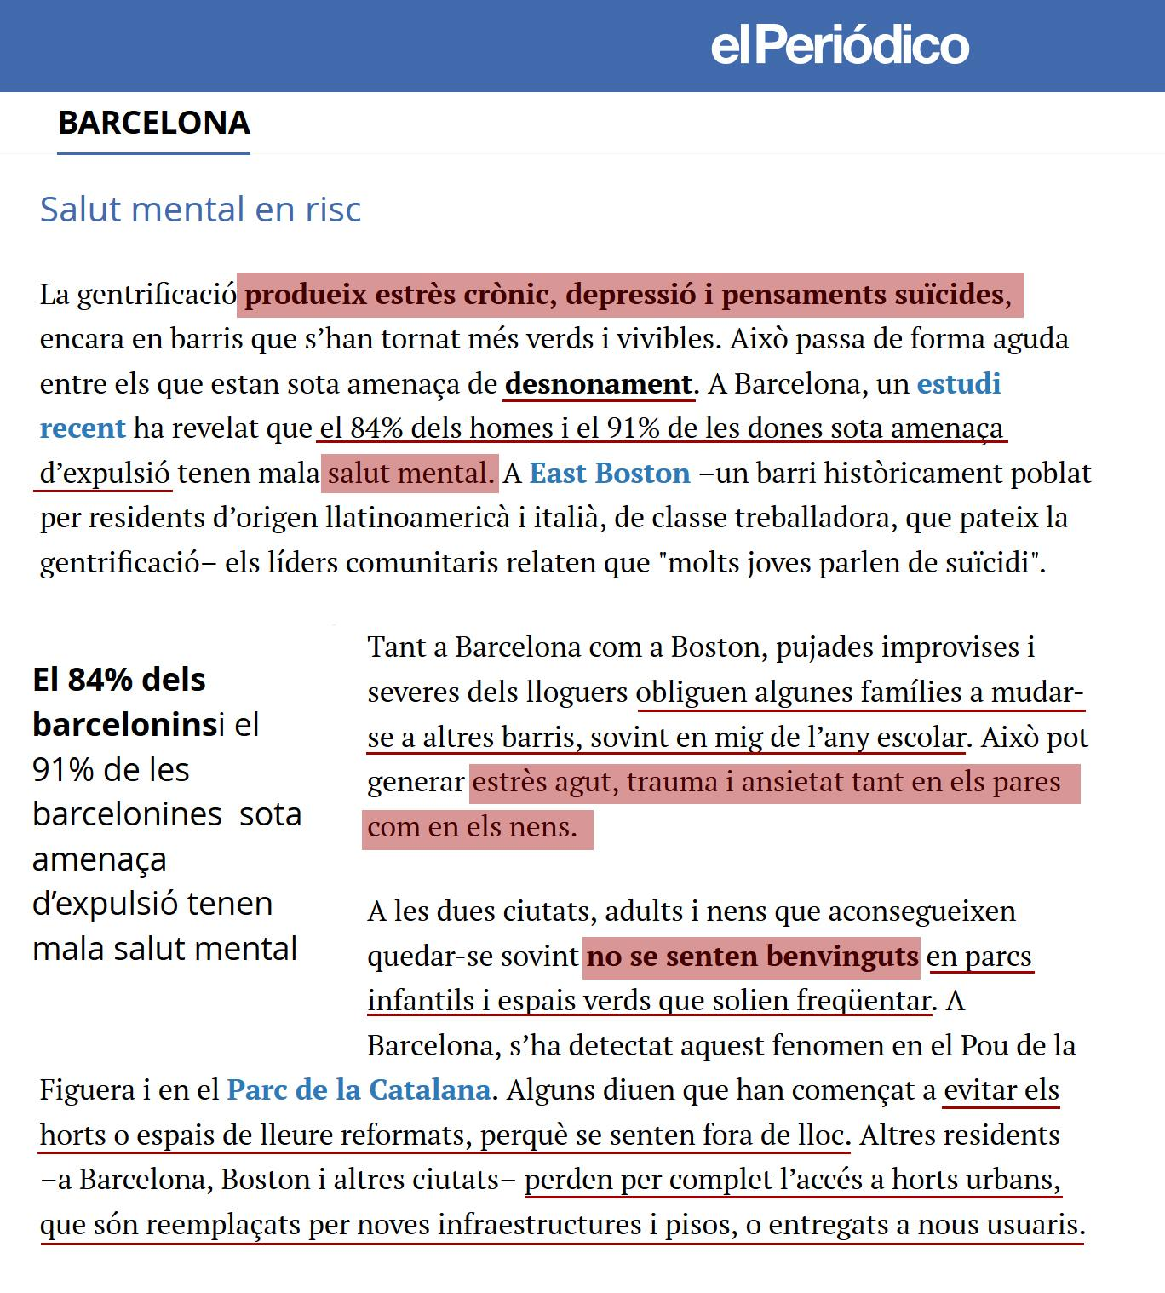
GENTRIFICATION CAN GENERATE ROUTINE CHANGES

Slide 5
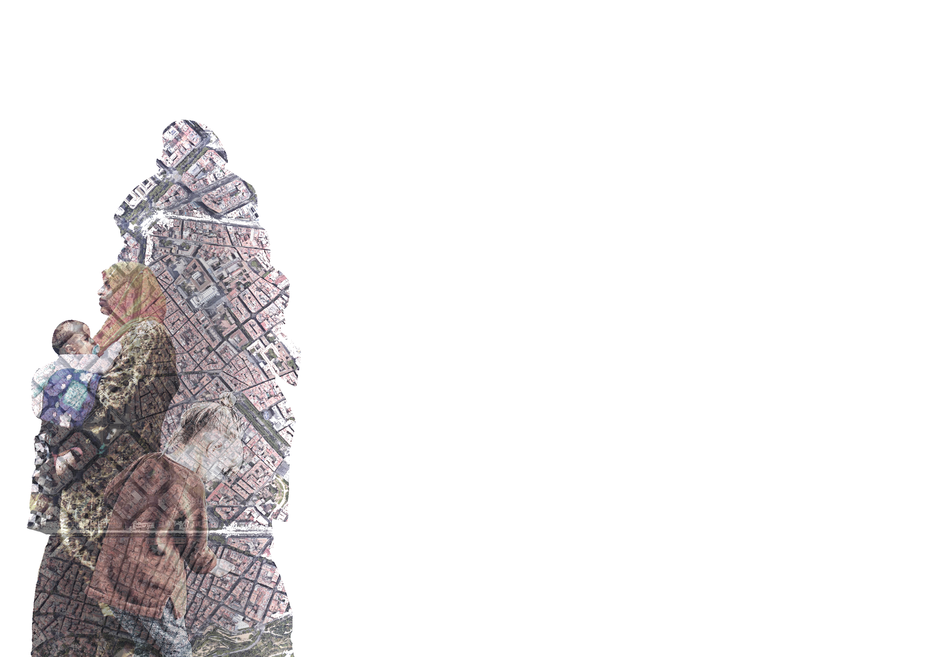
SOME EXAMPLES
Gentrification can generate routine changes
Increasing rent prices vs low increasing of income
Displacements of neighbours

Slide 6
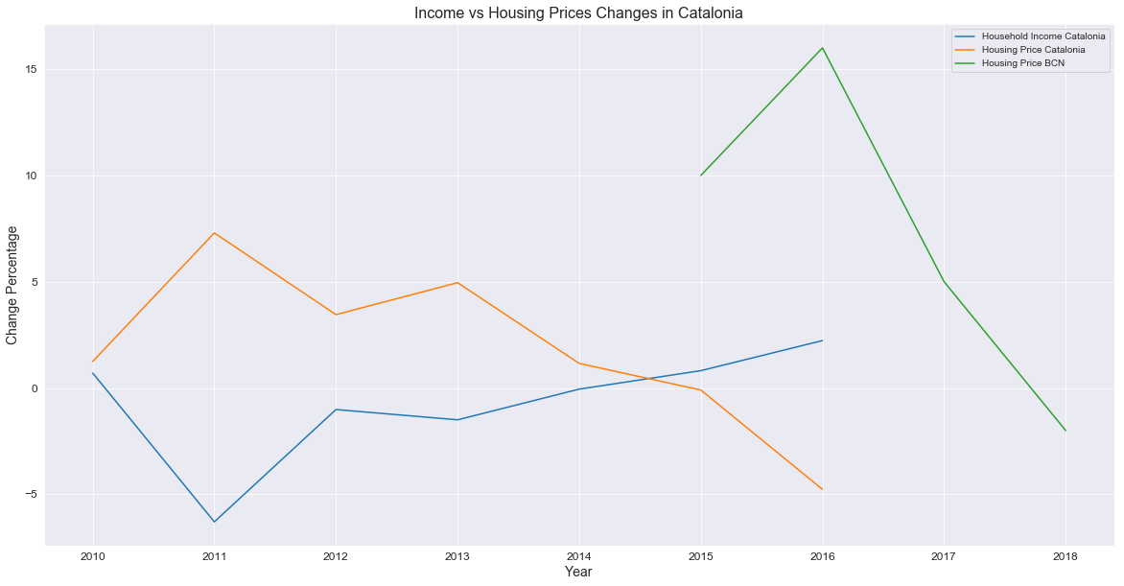
INCREASING RENT PRICES VS LOW INCREASING OF INCOME

Slide 7
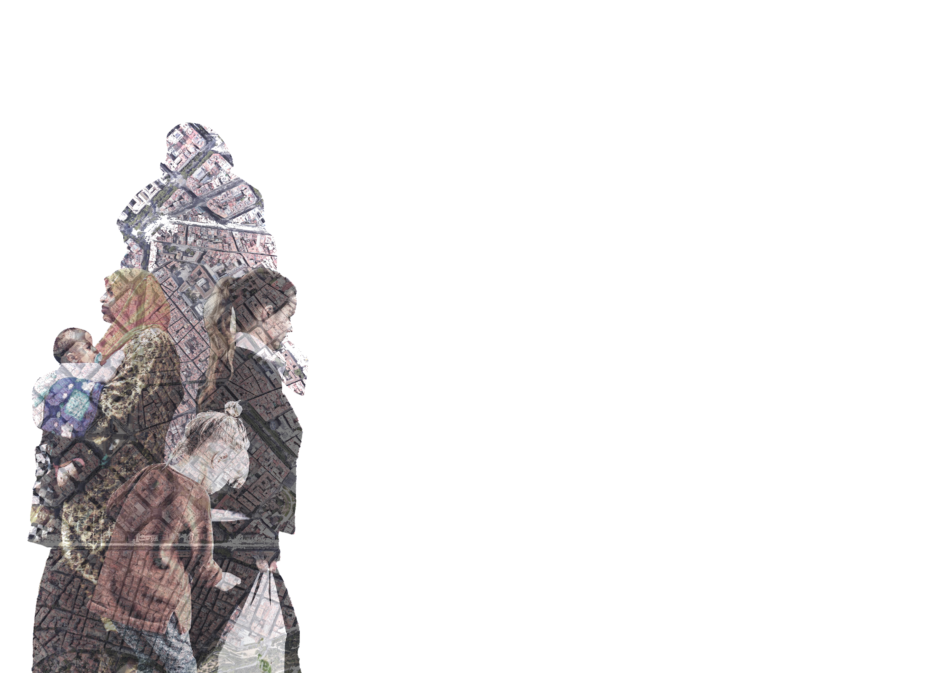
SOME EXAMPLES
Gentrification can generate routine changes
Increasing rent prices vs low increasing of income
Displacements of neighbours

Slide 8
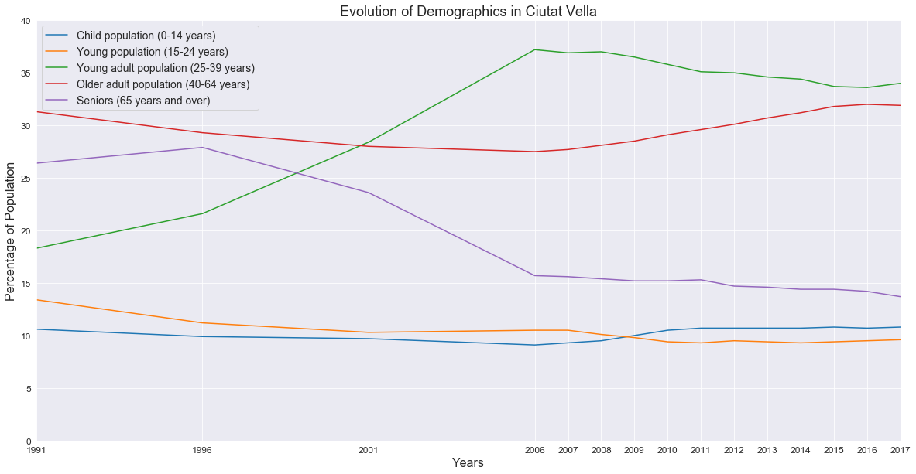
DISPLACEMENTS OF LOCAL NEIGHBOURS
Graph

Slide 9
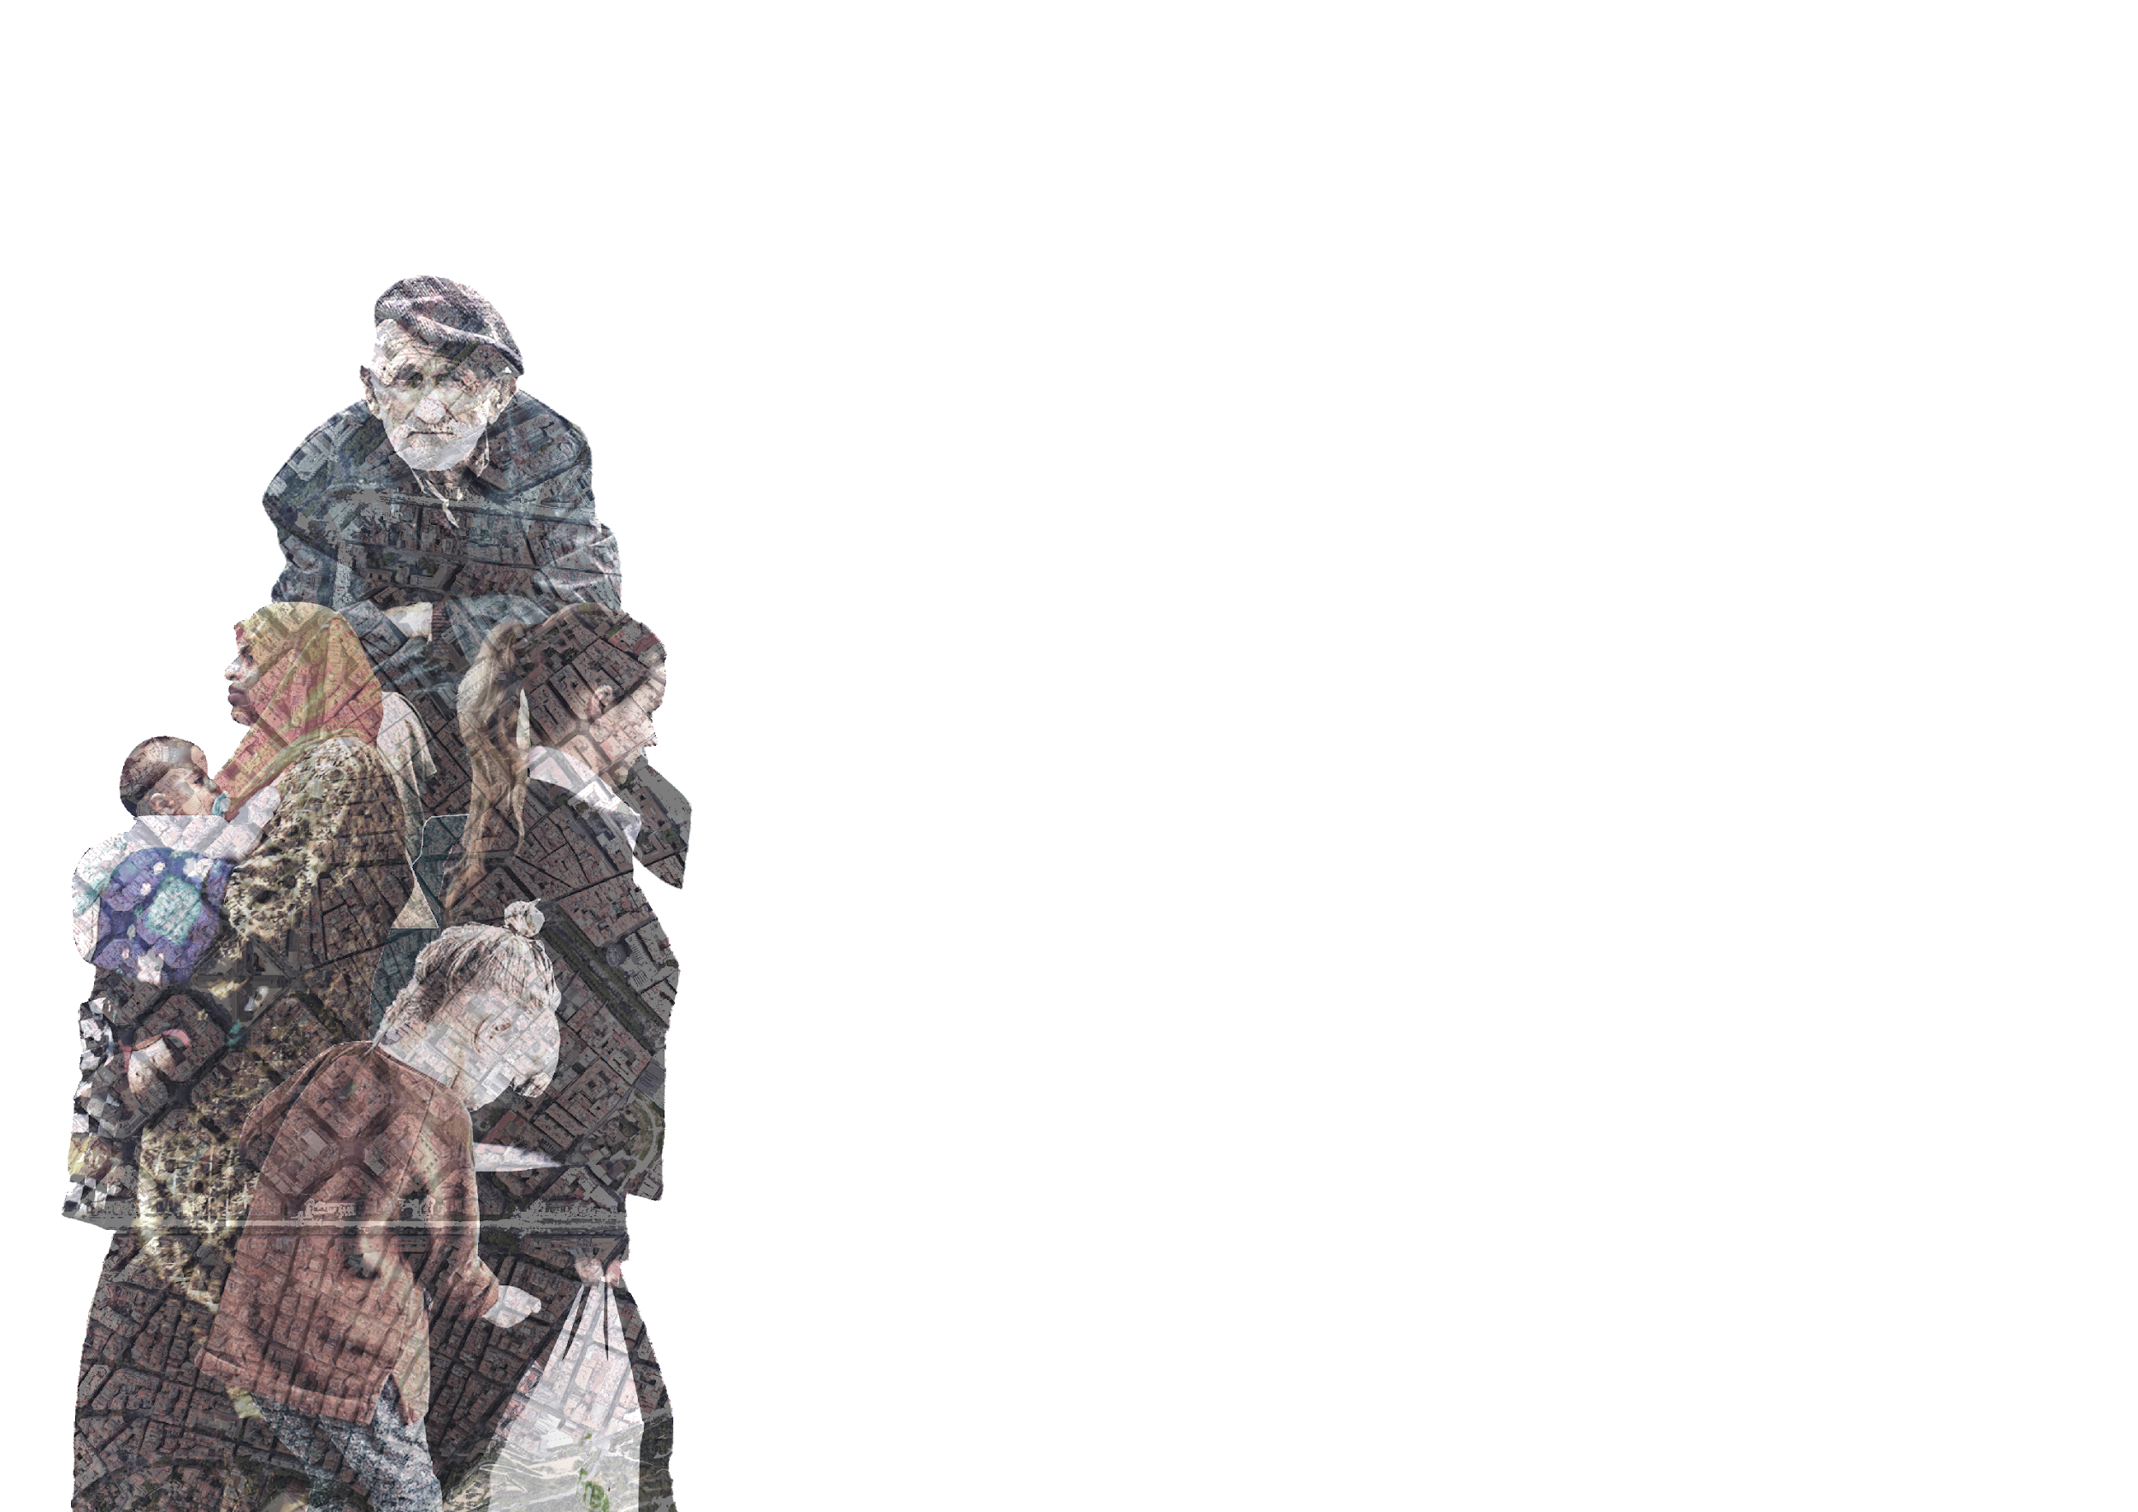
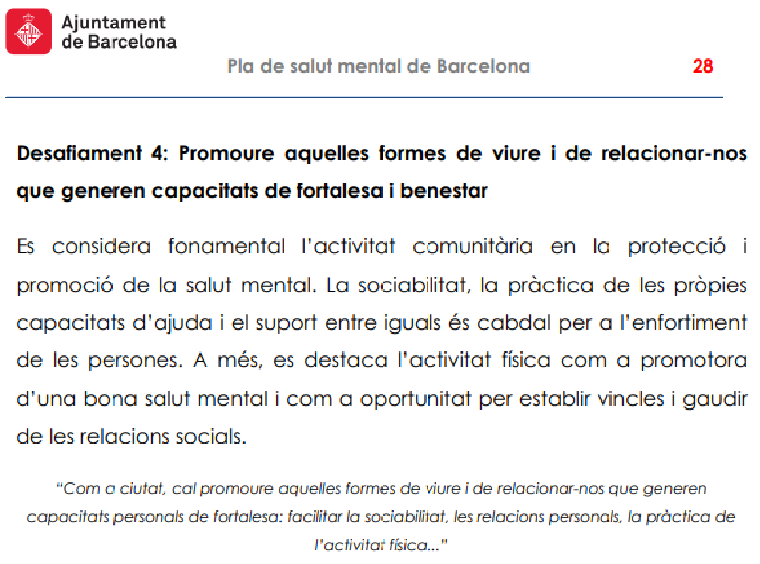
MENTAL HEALTH PLAN (2016-2022)

Slide 10
What is our resources?
Multiethnic neighbourhood
Social and cultural associations
Underused public space

Slide 11
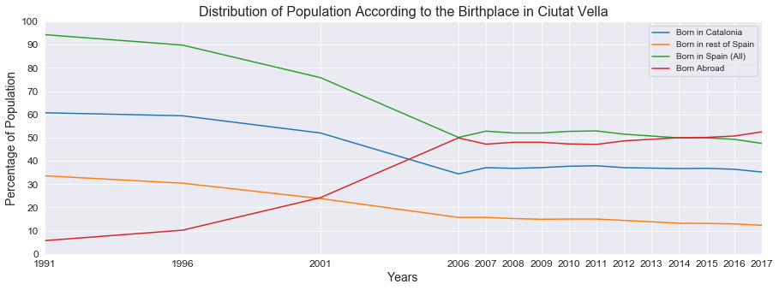
Multiethnic neighbourhoods

Slide 12
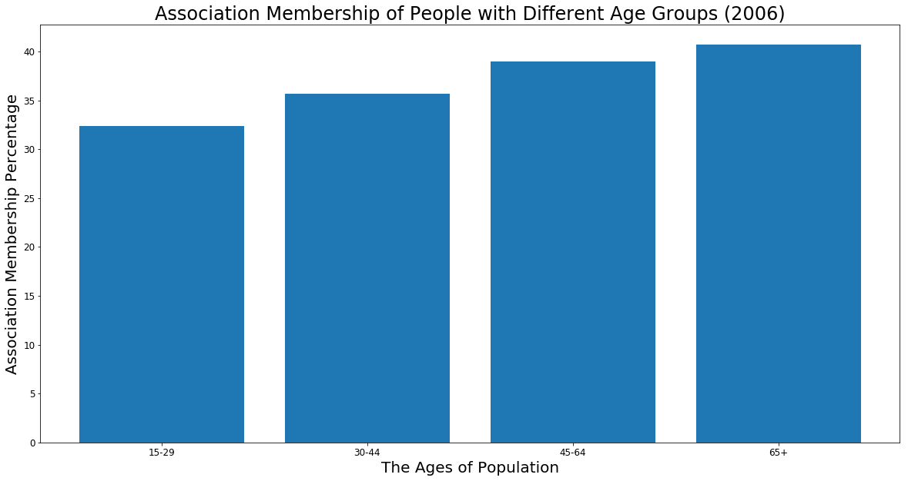
Social and cultural associations

Slide 13
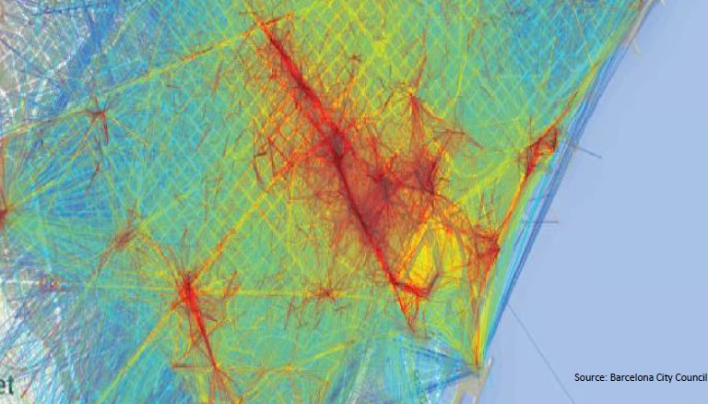
Underused public space

Slide 14
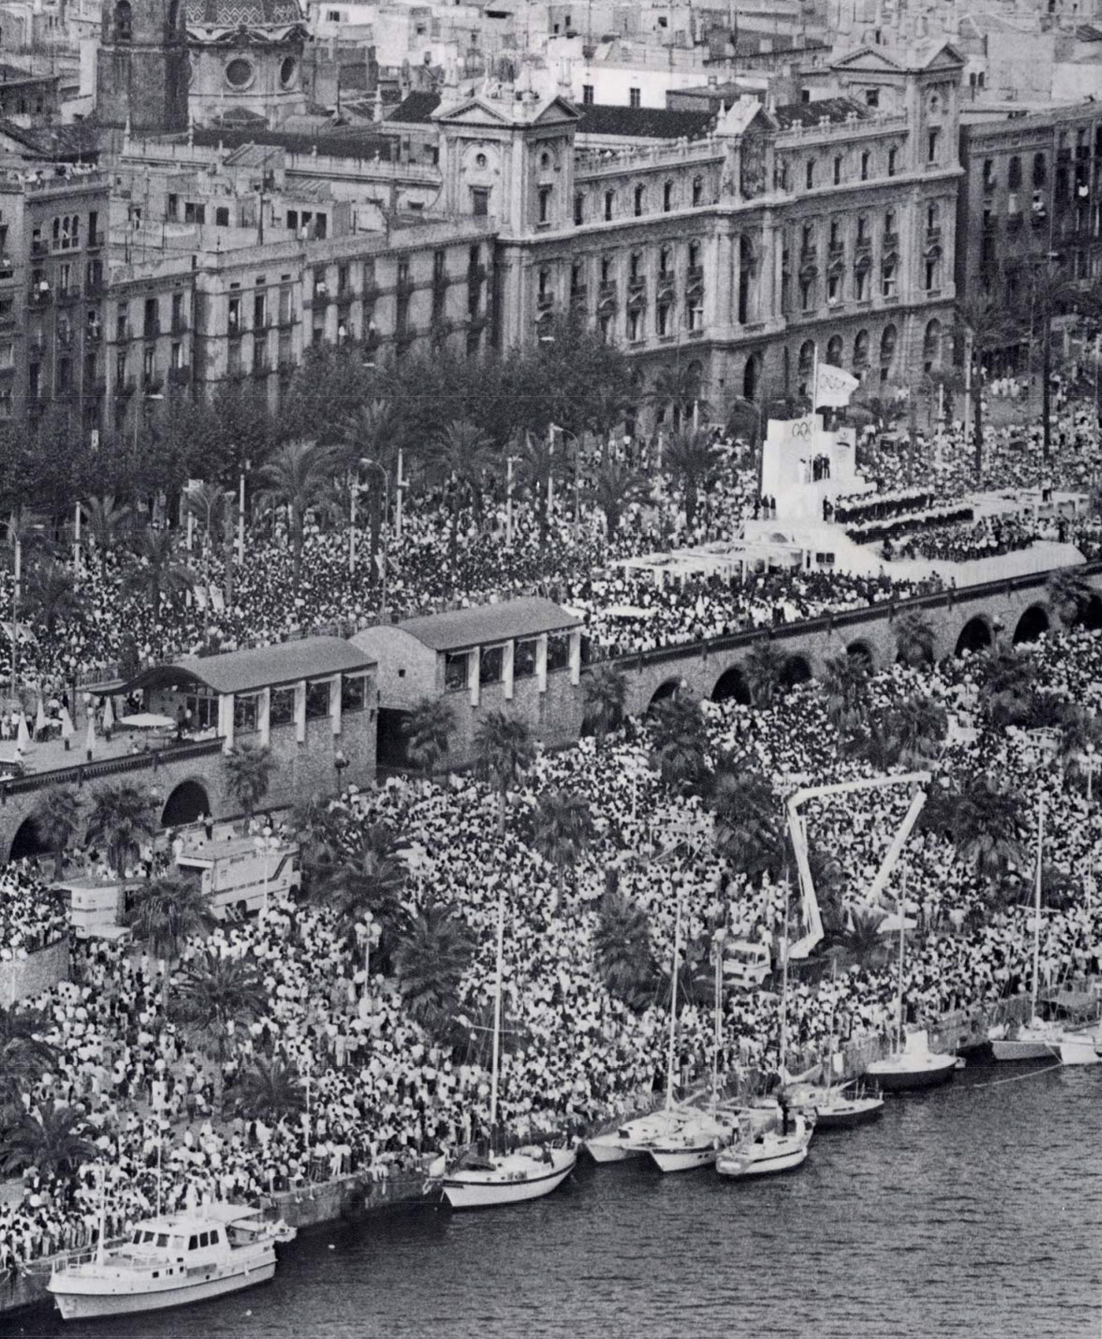
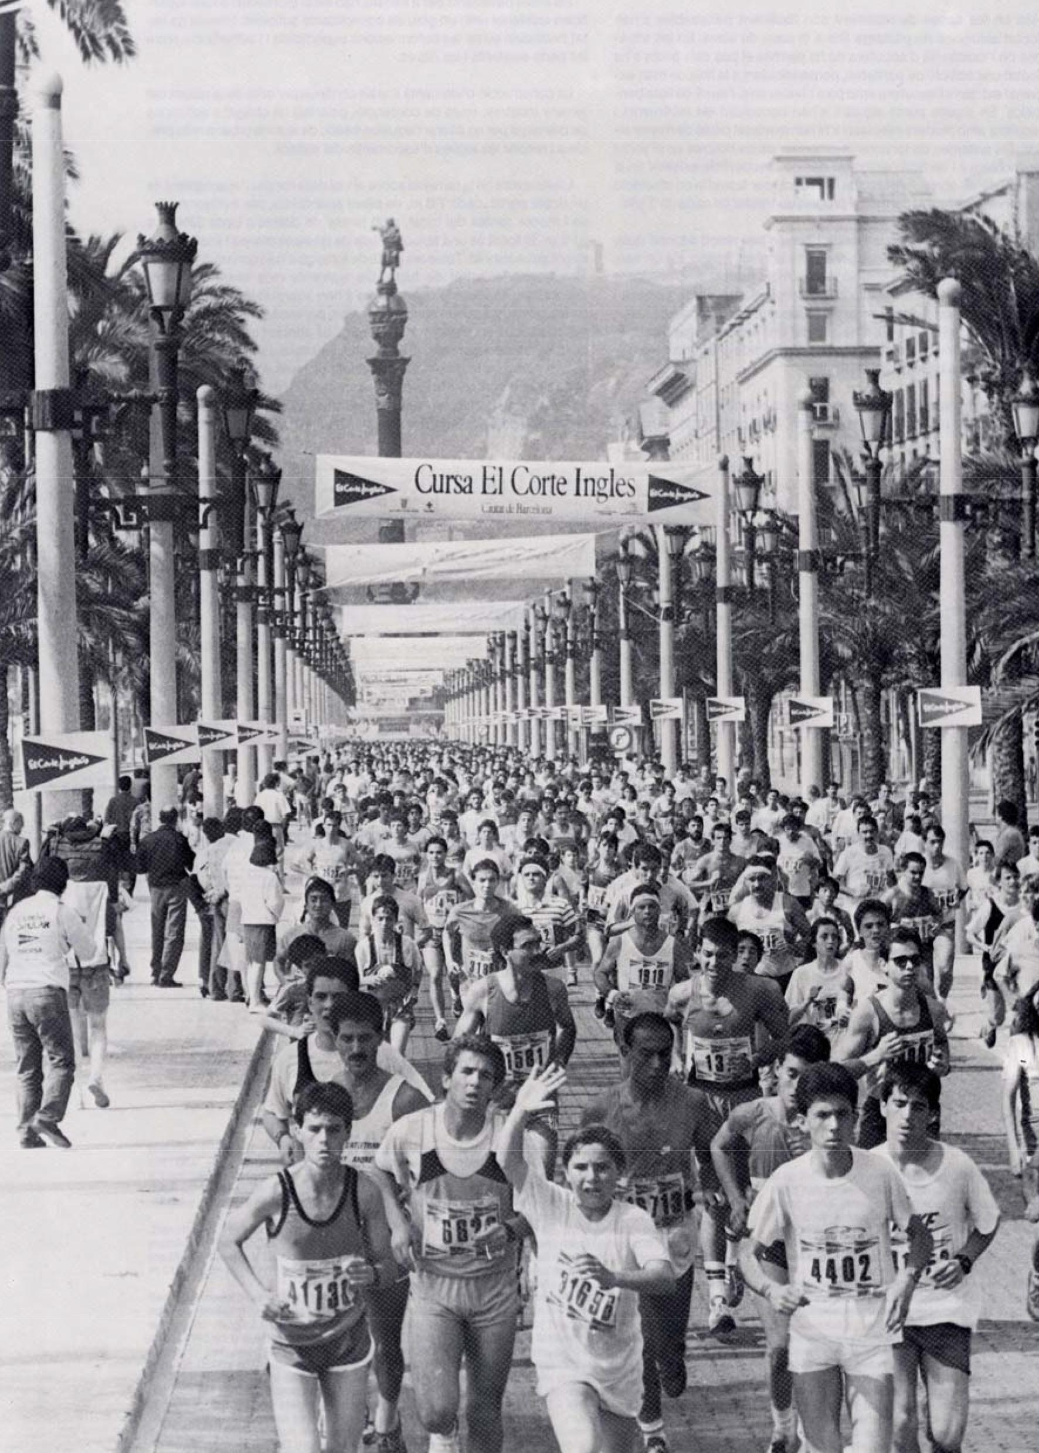

Slide 15
KEY SOLUTION
What? Physical and cultural activities (local flea markets, dancing, calçotades)
Who? Locals, tourists and associations
Where? Port Vell

Slide 16
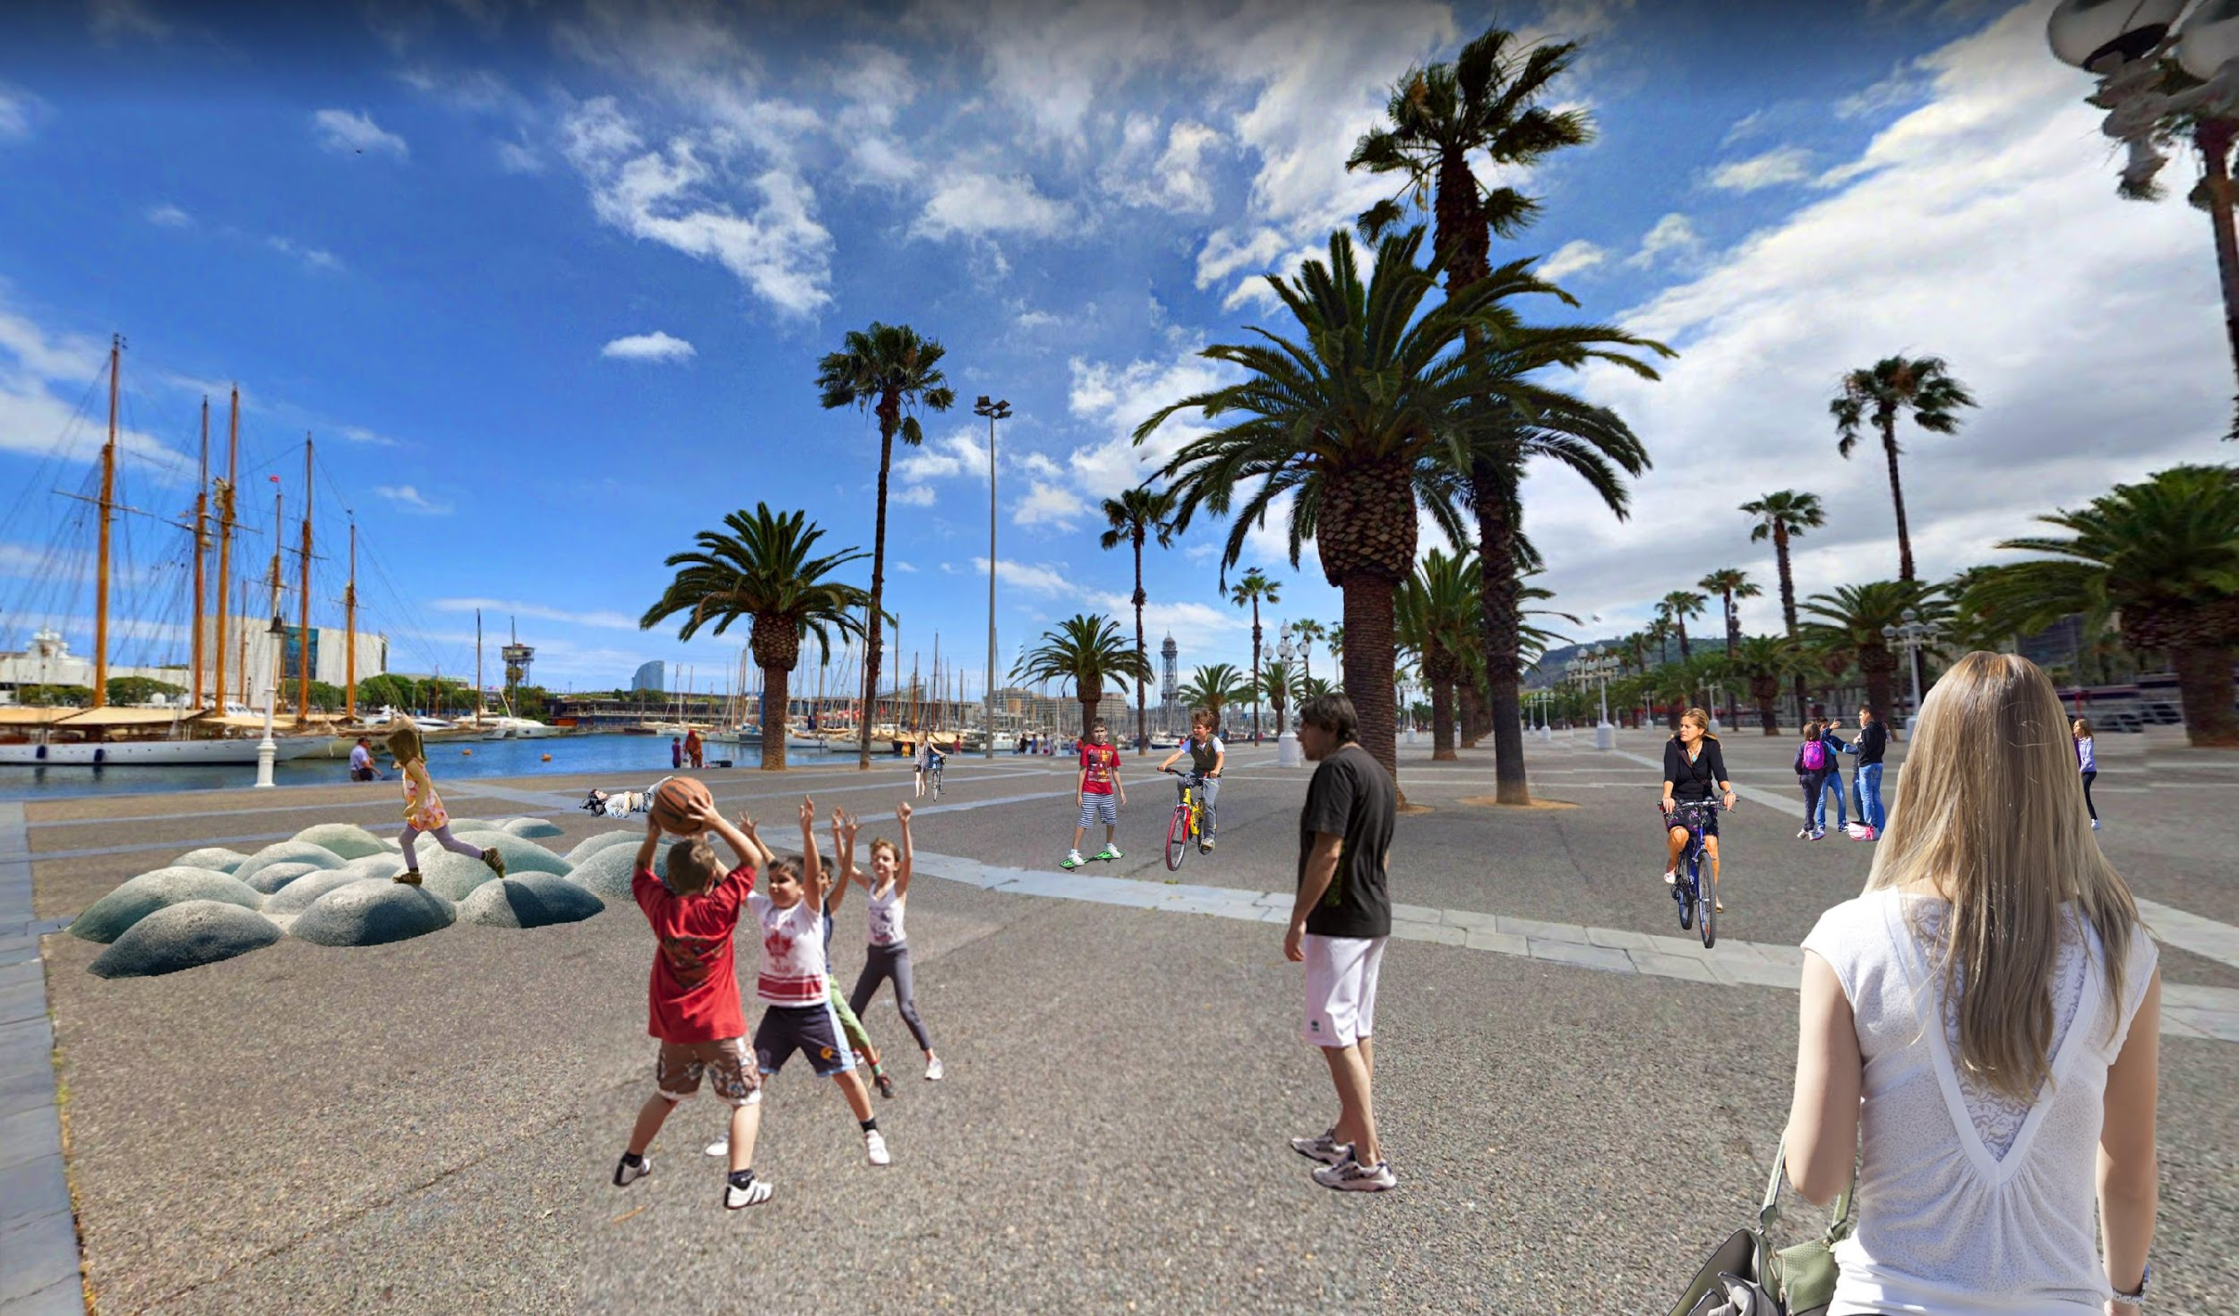

Slide 17
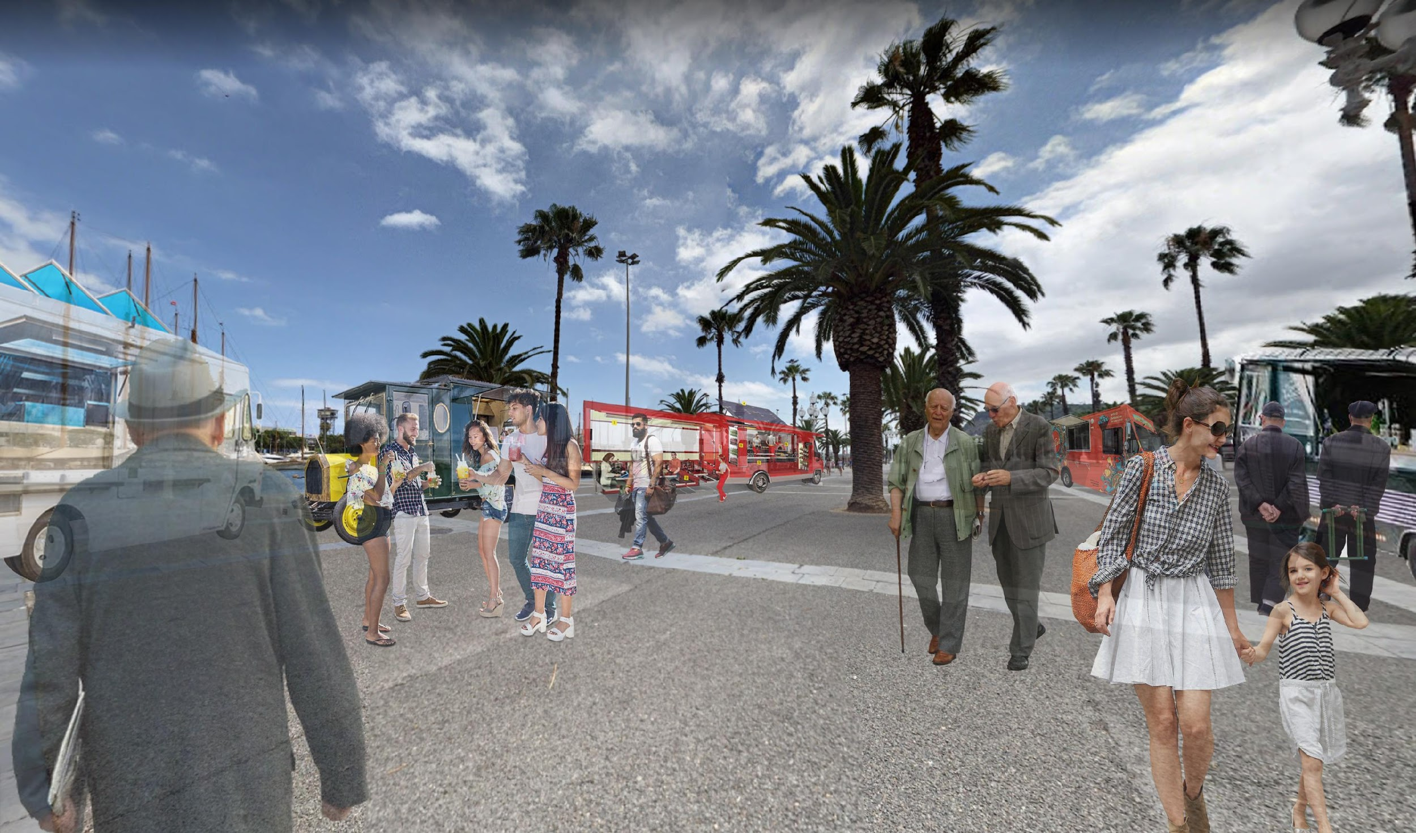

Slide 18
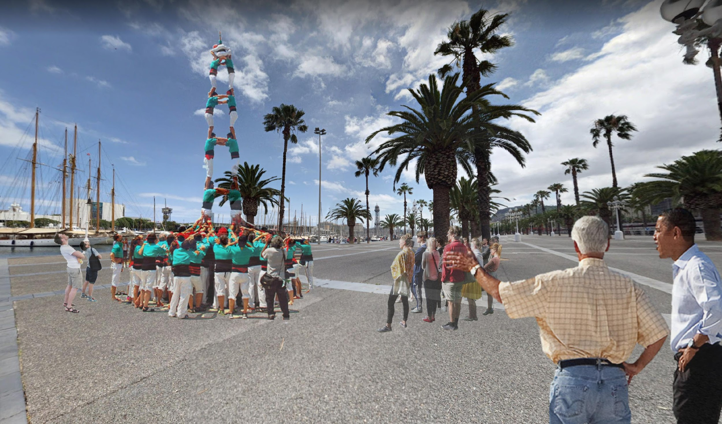

Slide 19
Positive externalities
Reduced social fragmentation
Better relationships between tourists and locals
Improved visibility of local associations

